Slide 1
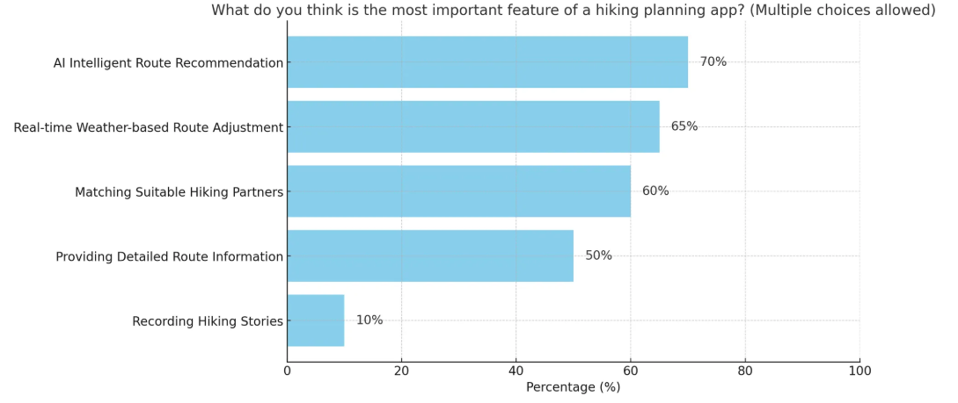
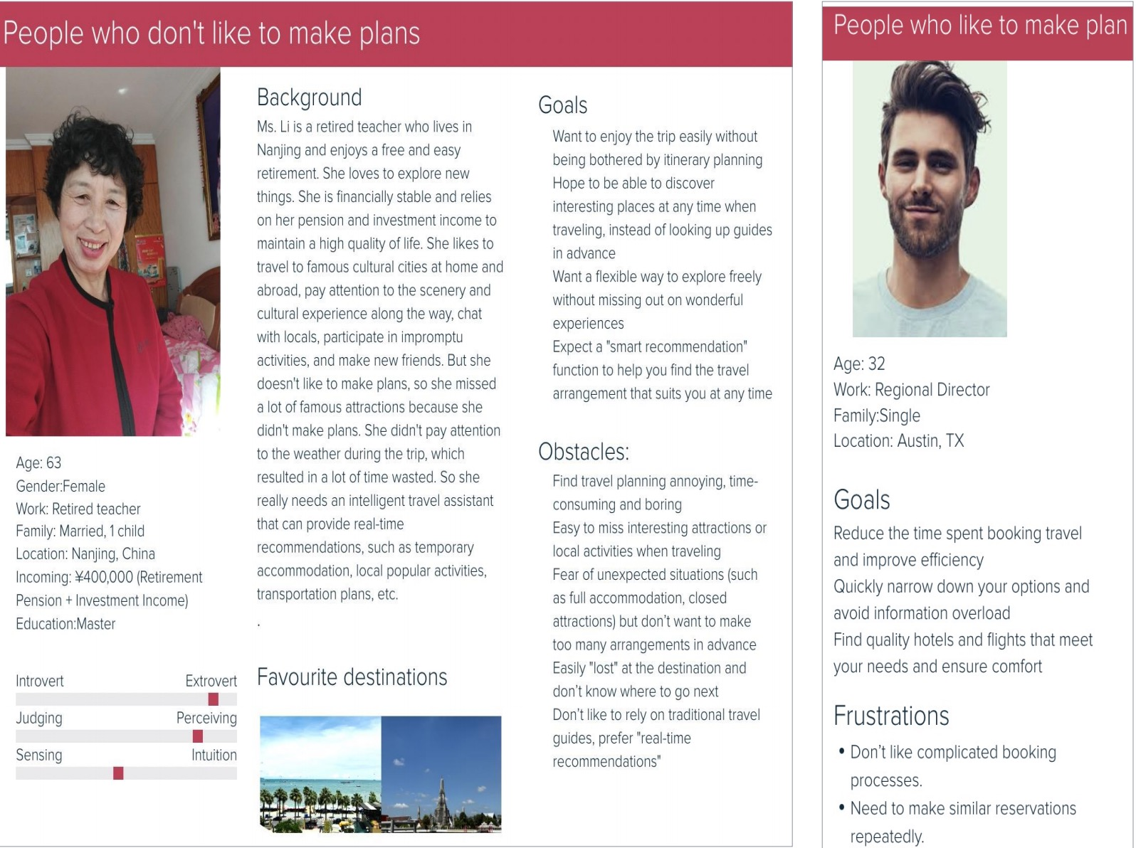
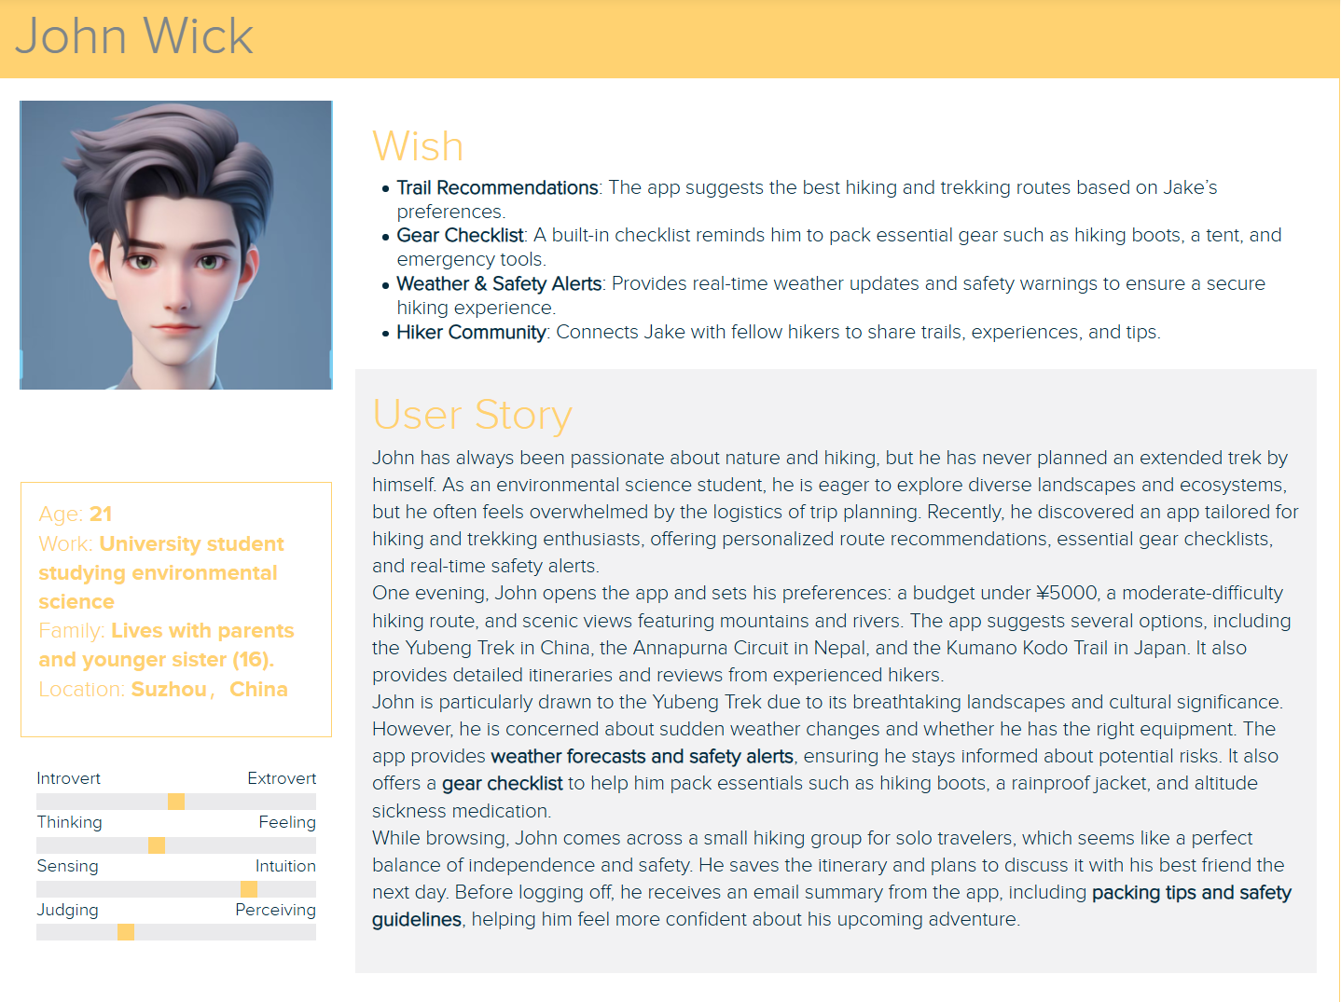
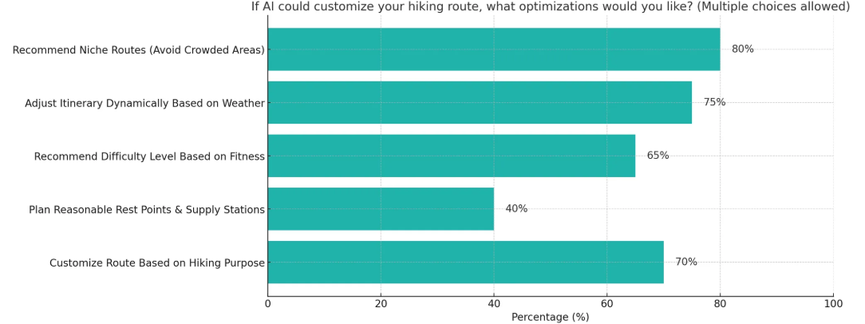
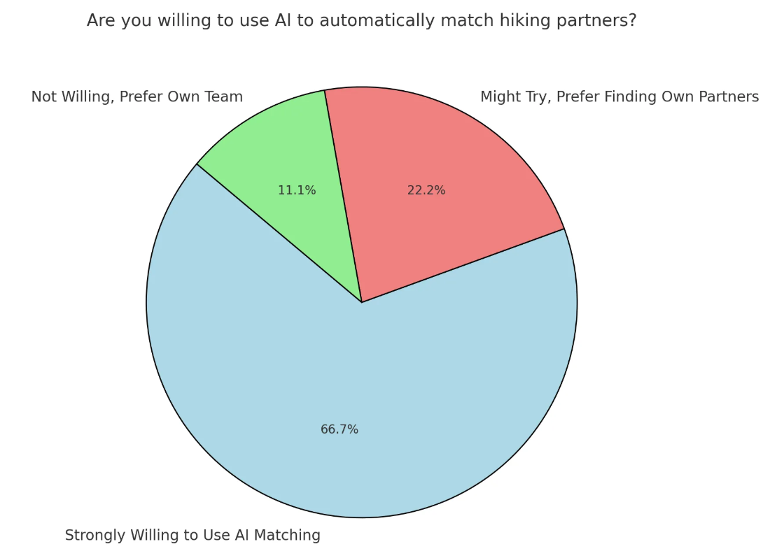
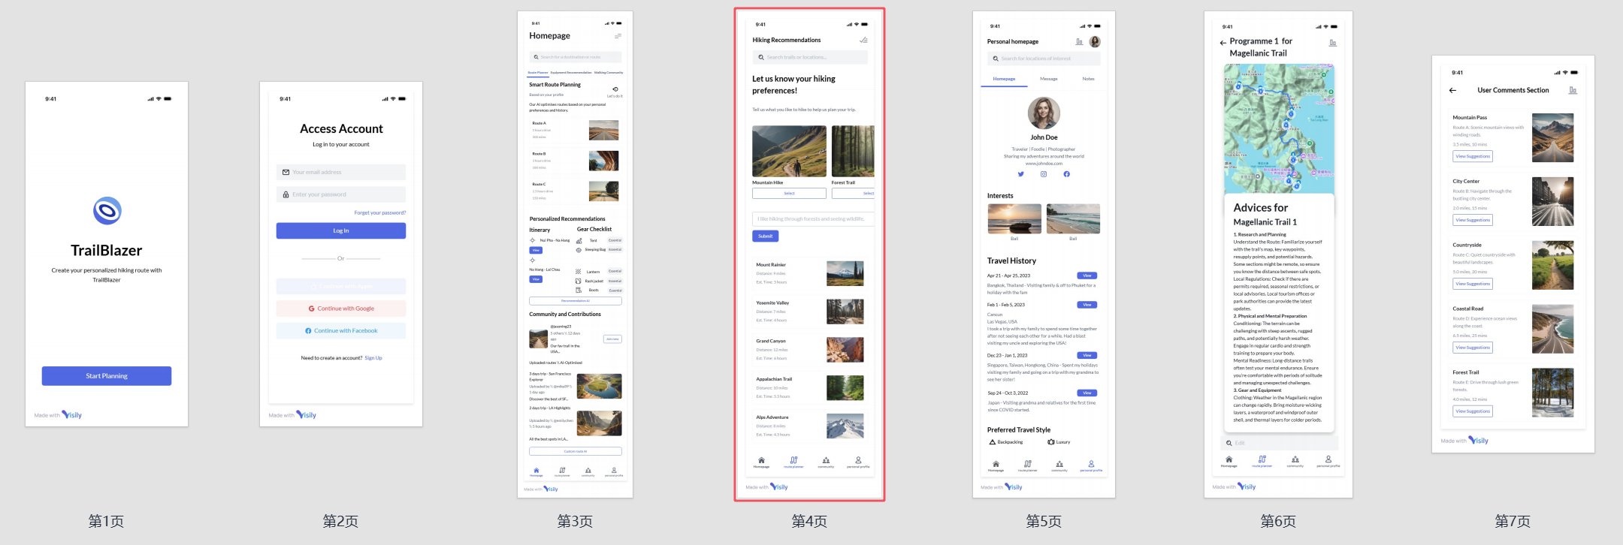
TraiBlazer
Hengqi.Liang Chengyang.Song Enze.Zhou Boyan.Li Yatao.Ouyang
REQUIREMENT
METHODOLOGY
Smart Route Planning: Optimize and adjust routes based on user fitness, experience, weather, and real-time conditions.
Live Route Adjustments: Adapt plans dynamically using real-time weather, terrain, and crowd data.
Personalized Gear & Trip Suggestions: Recommend suitable gear and itineraries based on terrain, weather, and user health data (steps, heart rate, oxygen levels).
Offline Mode: Enable route access and navigation without an internet connection.
AI-Powered Navigation: Offer 3D maps, elevation details, and AR-based guidance for better orientation.
Safety Features: Provide emergency alerts, one-tap SOS, route deviation warnings, and automatic health anomaly detection.
Smart Assistant: Support text, voice, and image-based interactions for real-time guidance.
Community & User Contributions: Allow users to share experiences, discuss routes, and upload custom trails for AI optimization.
Intelligent Route Generation: AI creates safe and customized hiking routes based on user preferences and safety assessments.
Our interaction design follows the interaction design lifecycle model [1], iteratively performing four basic activities (requirements discovery, alternative solution design, prototyping, and evaluation). 🔵 To describe the requirements, we had three team members create an atomic requirements shell, two user descriptions, and a scenario. Through the communication in weekly meetings, our team clarified the specific demand space and understood the description of the system content to be developed, including function, non-function, data, environment and user requirements.
In terms of data collection, our team conducted questionnaires and interviewed a series of people. To bring the requirements to life, we designed open-ended questions and multiple choice questions to get input on a variety of situations. 🟧 When designing the system, we explored several alternative designs to ensure that the final solution effectively met user needs and project objectives
In order to evaluate the system
The questionnaire combined closed-ended form and open-ended form and was disseminated by e-mail and friend circle.
Due to the inability to delve deeper and further explore the issues in the online questionnaire, we invited 20 individuals who completed the online questionnaire to conduct offline interviews.
In the requirement mock test, 12 interviewees are selected to conduct onsite requirement testing in the school’s supermarket.
Two experts have been invited to participate in the evaluation of our Health+ system.
In order to better meet the current market expectations and requirements, I also conducted two rounds of walkthrough based on Keep, a fitness software, to explore its advantages and disadvantages.
The first round of walkthrough is case introduction and observation, the second walkthrough is heuristic evaluation .
[First Character's Name] is the first character we have created. They are a [describe occupation, lifestyle, or interests] who [describe habits and behaviors]. As one of the target users, they strongly need a platform like [software name] to [describe key functionalities that assist this user].
[Second Character's Name] is the second character we have created. They are a [describe occupation, lifestyle, or interests] who [describe habits and behaviors]. They suffer from [mention challenges or pain points]. They need [software name] to [describe how the platform helps solve their issues].
DATA ANALYSIS
We collect 76 questionnaires and 20 interviews results to do the data collection, then analyzed and evaluated the results. From the conclusions, we made several iterative designs and improvements based on them. When we do the evaluation part we also add a requirement test, which lead the participants to the market to interview them about the use scenes of software. Moreover, we ask some of the experts for the advice and feedback data of our project
Name: Alex
Work: Software Engineer & Hiking Enthusiast
Age: 32
Location: Denver
Thinking: 85%
Extrovert: 50%
Feeling: 60%
Perceiving: 70%
Judging: 65%
Scenario 1
As an outdoor enthusiast, I need a smart route planning feature that considers my fitness level, experience, and weather conditions to recommend the best hiking trails. This helps me avoid overly difficult or unsafe routes.
Scenario 2
When hiking in remote areas, I often lose cellular signal. I want an offline mode that allows me to access maps, route details, and emergency contacts without an internet connection.
Scenario 3
Safety is a priority when hiking alone. I want real-time health monitoring to track heart rate, oxygen levels, and step count, with automatic alerts if my vitals drop to a dangerous level.
The above picture is the result of our questionnaire, which shows that most people have never used similar software before. Most users express ease of use of our software, and their satisfaction is generally high. Moreover, participants think that the most useful function is scanning the ingredients list of products for analysis. The right part is the key data values among the analysis.
The interview part we invited 20 people who are mainly college students. And we divide them into 4 groups to do the interview. According to the interview evaluation, we conducted detailed interviews with their experiences and found that the majority of users were satisfied with the design and layout of the prototype, especially the younger users. However, they also raised concerns about the language of the software, with some users unable to fully understand the full functionality of the software, and suggested that multi-language switching should be added.
During the evaluation and data collection, we mentioned that there are both positive points and negative parts that need to be improved. In the requirement mock test, nearly all of the participants affirm the necessity of our products and the demand in the market, experts also said that our software has good ideas and design. However, there were still defects in the detailed design. The representative mentioned that we need to take into account the accuracy of scanning results because there are some soft and flexible packaging. It is suggested that we add the function of directly searching products to increase the inclusiveness of functions. The switching of languages is a necessary function which is mentioned several times in the interview, because most of the people prefer to read Chinese to know more about our software design.
RESULT
Our group's prototype design basically covers all user functional requirements, and ultimately focuses on user needs, constantly iterating and improving. In addition, our prototype design maintains simplicity and clarity, avoiding excessive complex functions and redundant design elements, while maintaining consistency, improving user experience, reducing user confusion, and learning costs.

